Slide 1

ISO 22301:2019
Business continuity management systems
Notes:
Introduce About The organization

Slide 2
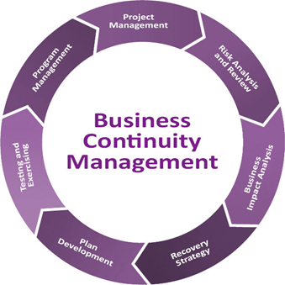
Business continuity management system
Gulf Consultant & Quality Center WLL
Notes:
A business continuity management system, or BCMS for short, is a management system that bundles interrelated methods, procedures and rules to ensure that critical business processes keep running in the event of an unexpected disruption happened and continuously develops and improves them.

Slide 3

WHY WE NEED A BUSINESS CONTINUITY MANAGEMENT SYSTEM
A BCMS is crucial for ensuring an organization's resilience during unexpected disruptions and minimizes downtime.
Gulf Consultant & Quality Center WLL
Notes:
Discuss About any Recent Innovation Happened In Qatar

Slide 4

Identify Potential risks
Business continuity makes this possible by establishing actions that must be taken to ensure operations remain active, no matter the nature of the disaster.
Gulf Consultant & Quality Center WLL
Notes:
Discuss About any Recent Innovation Happened In Qatar

Slide 5
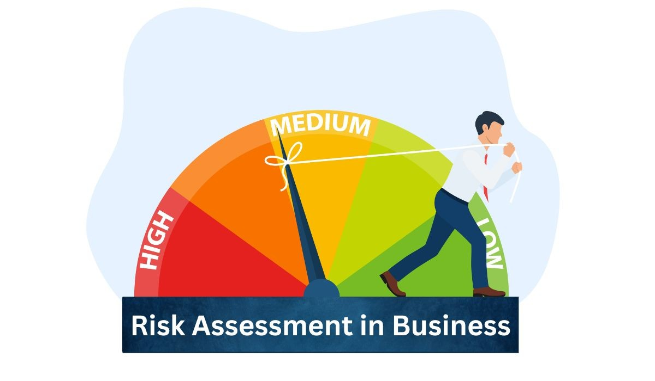
Risk assessment based on
BUSINESS CONTINUITY MANAGEMENT SYSTEM
The Business Continuity Risk Assessment aims to identify, analyze and evaluate the risks of disruption to a business.
Gulf Consultant & Quality Center WLL
Notes:
Discuss About any Recent Innovation Happened In Qatar

Slide 6
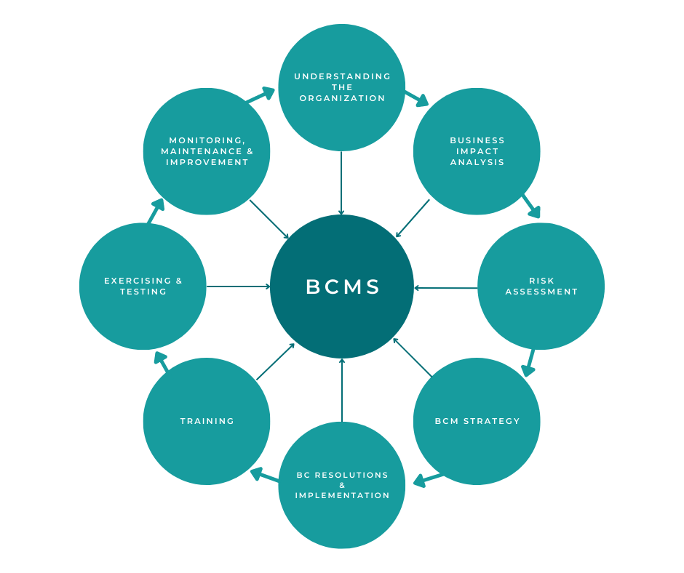
Elements of Business continuity management system
Understanding the organization
Risk Assessment
Business Impact Analysis
BCM Strategy
Business Continuity Plan
BC Resolution and Implementation
Trainings
Exercising and Testing
Monitoring, Maintenance and Improvement
Gulf Consultant & Quality Center WLL
Notes:
Discuss About any Recent Innovation Happened In Qatar

Slide 7
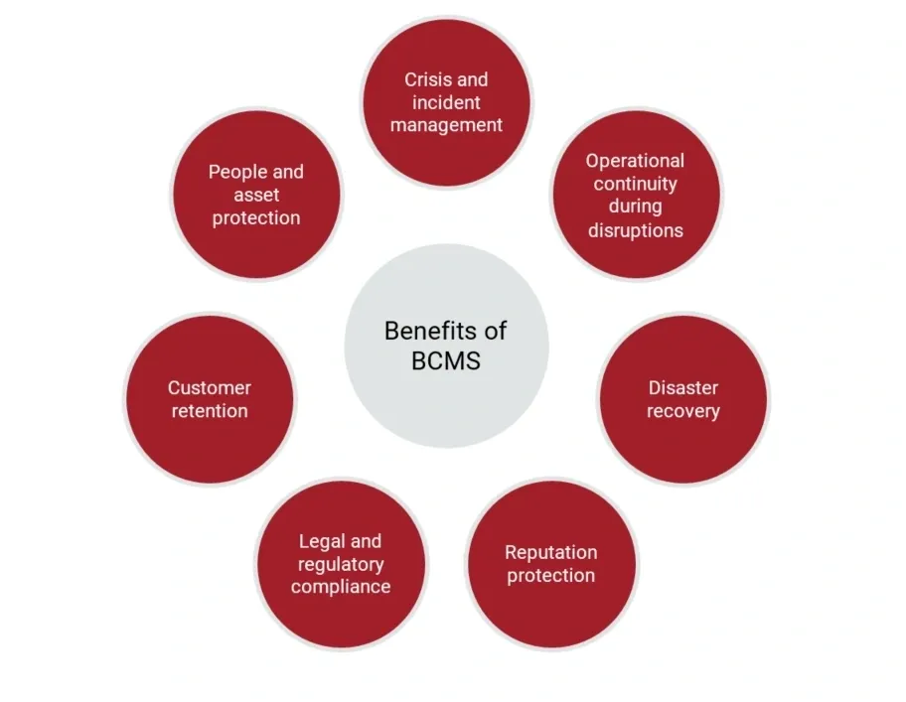
Benefits of implementing bcms
Minimizing Downtime and Losses
Crisis and Incident Management
Operational Continuity During Disruptions
Disaster Recovery
Reputation Protection
People and Asset Protection
Customer Retention
Stakeholder Trust
Preventing Data Losses
Gulf Consultant & Quality Center WLL
Notes:
Discuss About any Recent Innovation Happened In Qatar

Slide 8
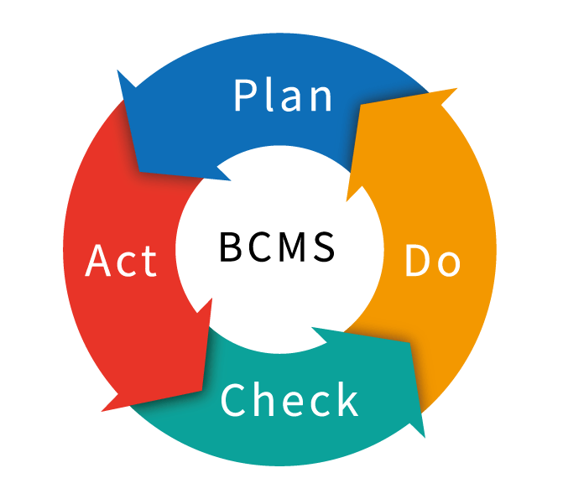
Steps of implementing bcms
Planning – Business Continuity Plan
Establishment
Business Risk & Opportunity Assessment
Business Impact Analysis
Develop a Business continuity strategy
Develop the required documentations
Provide trainings
Testing, Monitoring and Improvement
Gulf Consultant & Quality Center WLL
Notes:
Discuss About any Recent Innovation Happened In Qatar

Slide 9
We can assist in implementation of bcms
Gap Analysis Audit
Identifying the context and scope of BCMS
Preparation of the required documents as per the ISO 22301: 2019
Business Risk Assessment
Developing mitigation plans for the identified potential risks.
Trainings for the implementation of the BCMS in each process required for the business continuity
Conducting internal audits and identifying areas for improvements
Proposing the corrective actions to close the identified gaps/NCRs
Developing the Improvement Strategy
Gulf Consultant & Quality Center WLL
Notes:
Discuss About any Recent Innovation Happened In Qatar

Slide 10
Thank you
?
Gulf Consultant & Quality Center WLL

